Slide 1


Insert relevant picture related to the topic
ALGORITHMS AND DATA STRUCTURES
TEB1113/TFB2023
WEEK IV
LINKED LIST – II (CIRCULAR LINKED LIST)
FARAHIDA HANIM BT MAUSOR - DR (FSMC/UTP)
BACHELOR OF XXXXXX
DEPARTMENT OF COMPUTING
FACULTY OF SCIENCE, MANAGEMENT & COMPUTING
© 2026 INSTITUTE OF TECHNOLOGY PETRONAS SDN BHD
All rights reserved. No part of this document may be reproduced, stored in a retrieval system or transmitted in any form or by any means (electronic, mechanical, photocopying, recording or otherwise) without the permission of the copyright owner.

Slide 2
RECAP FROM PREVIOUS LECTURE
A linked list is made of nodes connected by pointers.
A singly linked list supports forward traversal only.
A doubly linked list supports forward and backward traversal.
Linked lists allow dynamic memory allocation but require extra pointer memory.
Notes:
Learning Outcomes Slide
Note:
Include 2–4 lecture-level learning outcomes
Use measurable action verbs
Map explicitly to Course Learning Outcomes (CLOs)

Slide 3
LEARNING OUTCOMES
Explain the structure of a circular linked list.
Differentiate singly, doubly, and circular linked lists.
Trace insertion, deletion, and traversal in a circular linked list.
Implement circular linked list operations in C++.
Notes:
Learning Outcomes Slide
Note:
Include 2–4 lecture-level learning outcomes
Use measurable action verbs
Map explicitly to Course Learning Outcomes (CLOs)

Slide 4
TOPICS
Circular Linked List Concept
Difference from Singly and Doubly Linked Lists
Circular Traversal
Insertion Operations
Deletion Operations
C++ Lab Practice
Notes:
Learning Outcomes Slide
Note:
Include 2–4 lecture-level learning outcomes
Use measurable action verbs
Map explicitly to Course Learning Outcomes (CLOs)

Slide 5

LINKED LIST – II
(CIRCULAR LINKED LIST)
Introduction

Slide 6
INTRODUCTION
1.1. CIRCULAR LINKED LIST
A circular linked list is a linked list where the last node points back to the first node. Unlike a normal singly linked list, the final node does not point to NULL.
The last node points back to the head.
Traversal can continue in a loop.
There is no NULL at the end.
A stopping condition is required during traversal.
Notes:
Engagement and Activity Slides
Note:
Include at least one engagement element where appropriate:
Think–Pair–Share
Mini task
Poll or reflection question
Suggested duration: 3–5 minutes
Activities shall align with learning outcomes

Slide 7
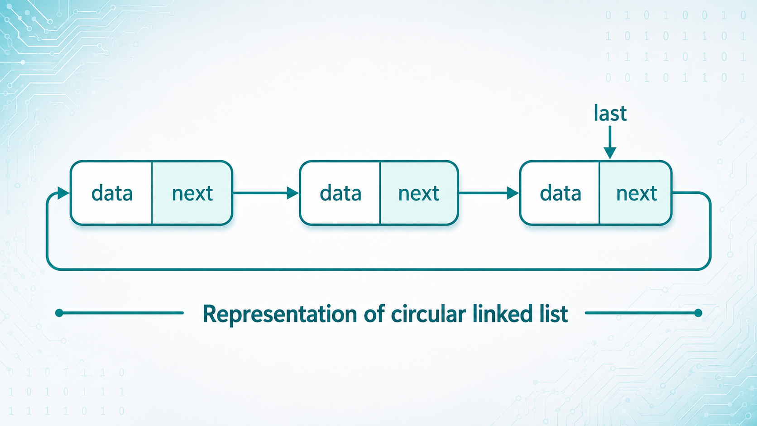
CIRCULAR LINKED LIST
Notes:
Engagement and Activity Slides
Note:
Include at least one engagement element where appropriate:
Think–Pair–Share
Mini task
Poll or reflection question
Suggested duration: 3–5 minutes
Activities shall align with learning outcomes

Slide 8
SINGLY VS DOUBLY VS CIRCULAR
Feature | Singly Linked List | Doubly Linked List | Circular Linked List
Last node points to | NULL | NULL | head
Direction | Forward only | Forward and backward | Usually forward circular
Pointers per node | next | prev, next | next
Traversal stop | NULL | NULL | Back at head
Main use | Simple dynamic list | Two-way navigation | Repeated/cyclic processing
Notes:
Engagement and Activity Slides
Note:
Include at least one engagement element where appropriate:
Think–Pair–Share
Mini task
Poll or reflection question
Suggested duration: 3–5 minutes
Activities shall align with learning outcomes

Slide 9
SUMMARY
TODAY’S KEY TAKEAWAYS:
A circular linked list connects the last node back to the head.
Circular linked lists do not end with NULL.
Traversal must stop when the pointer returns to the head.
Insertions and deletions require careful pointer updates.
Circular linked lists are useful for repeated or cyclic processing.
Notes:
Engagement and Activity Slides
Note:
Include at least one engagement element where appropriate:
Think–Pair–Share
Mini task
Poll or reflection question
Suggested duration: 3–5 minutes
Activities shall align with learning outcomes

Slide 10
LAB TASK
CREATE A C++ PROGRAM
Your program should include:
Insert node at the beginning.
Insert node at the end.
Delete node from the beginning.
Delete node from the end.
Delete node by value.
Display the circular linked list.
Notes:
Engagement and Activity Slides
Note:
Include at least one engagement element where appropriate:
Think–Pair–Share
Mini task
Poll or reflection question
Suggested duration: 3–5 minutes
Activities shall align with learning outcomes

Slide 11

THANK YOU
FARAHIDA HANIM BT MAUSOR - DR (FSMC/UTP)
DEPARTMENT OF COMPUTING
farahida.mausor@utp.edu.my
02-03-26

